Slide 1

CUSTOMER CHURN PREDICTION Machine learning Based Project
Presented By: Ashutosh Kumar Singh
Program: PBEL 3.0 – AI Batch 4

Slide 2
PROJECT OBJECTIVE
To analyze customer related data
To predict whether a customer is likely to churn
To apply machine learning for churn prediction
To provide a simple web interface for prediction

Slide 3
TECHNOLOGIES USED
Python
Pandas & Numpy
Matplotlib
Scikit-learn
Flask
HTML
Jupyter Notebook

Slide 4
PROJECT WORKFLOW
Data Collection ⟶ Data preprocessing ⟶ Data Analysis ⟶ Model Training ⟶ Prediction ⟶ Web Application

Slide 5
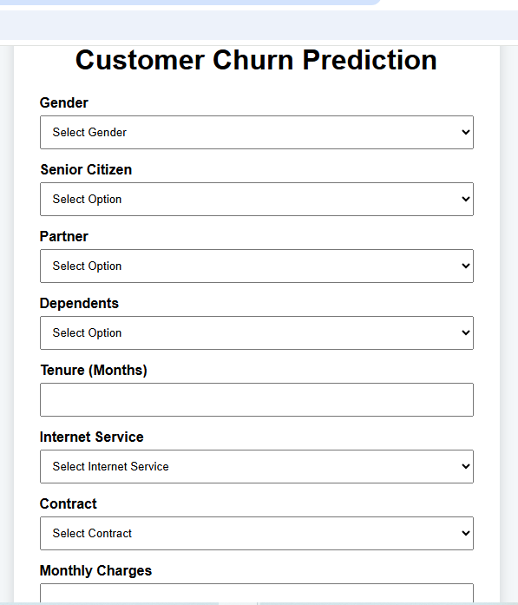
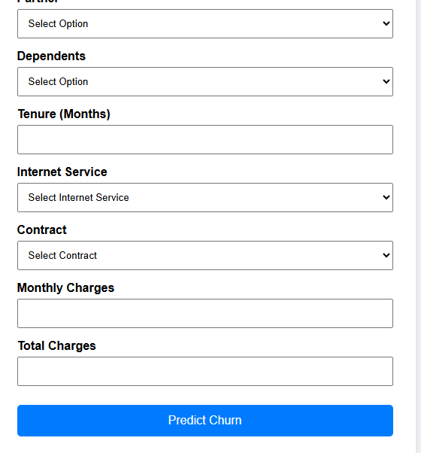
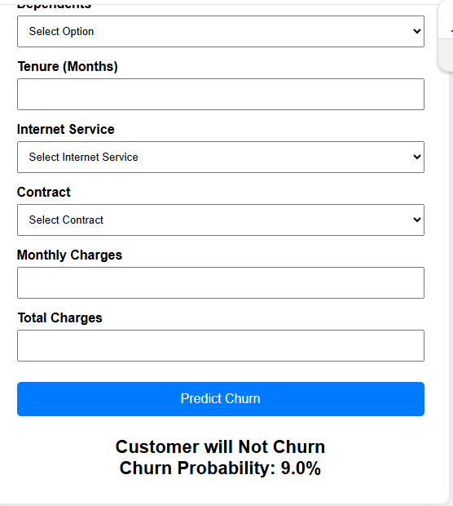
PROJECT OUTPUT
User enters the required customer details
The trained model processes the entered information
The application predicts the Customer’s Churn Status
The result is displayed through a simple web interface

Slide 6
CONCLUSION
The project demonstrates the practical use of machine learning
It helps identify customers who may leave a service
The prediction system is integrated with a simple Flask-based web application

